Slide 1
Twitter Sentiment Analysis
BY
Adnan Amin

Slide 2
Sentiment analysis
also known as opinion mining
refers to the use of natural language processing, text analysis, and computational linguistics to identify and extract subjective information in source materials.
The ability to categorize opinions expressed in the text of tweets—and especially to determine whether the writer's attitude is positive, negative, or neutral—is highly valuable.

Slide 3
Why Sentiment analysis
Traditionally, most of the research in sentiment analysis has been aimed at larger pieces of text, like movie reviews, or product reviews.
Consumers can use sentiment analysis to research products and services before a purchase.
Production companies can use public opinion to determine the acceptance of their products and the public demand.
Movie-goers can decide whether to watch a movie or not after going through other people’s reviews.

Slide 4
Ordinal scales for Sentiment Analysis
ordinal scales are used to categorize tweets.
A five-point ordinal scale includes five categories: Highly Negative, Slightly Negative, Neutral, Slightly Positive, and Highly Positive.
A three-point ordinal scale includes Negative, Neutral, and Positive.
two-point ordinal scale includes Negative and Positive.

Slide 5
Twitter Sentiment Analysis
Tweets are more casual and are limited by 140 characters.
Programming time
Grammar and content both suffer at the hands of the tweeter
Usernames:
are mentioned more often than not. Usually, they consist of some alphabets and numbers and do not contribute much towards sentiment classification, except for increasing the size of the feature vector.
URLS too are not required

Slide 6
Twitter Sentiment Analysis challenges
Repeated letters
People often repeat letters in some words, in order to stress upon a particular emotion.
For example:- sad, saaaad, saaaddd. All of them mean the same, yet it is not possible to distinguish between them if guided only by their spellings.
Hashtags
Words in hashtags may be read differently from the same word without the hashtag
Punctuations and additional spaces.

Slide 7
Pre-processing Tweets
Letter casing: Converting all letters to either upper case or lower case.
Tokenizing: Turning the tweets into tokens. Tokens are words separated by spaces in a text.
Noise removal: Eliminating unwanted characters, such as HTML tags, punctuation marks, special characters, white spaces etc.
Stopword removal: Some words do not contribute much to the machine learning model, so it's good to remove them. A list of stopwords can be defined by the nltk library, or it can be business-specific.

Slide 8
Pre-processing Tweets
Normalization: Normalization generally refers to a series of related tasks meant to put all text on the same level. Converting text to lower case, removing special characters, and removing stopwords will remove basic inconsistencies. Normalization improves text matching.
Stemming: Eliminating affixes (circumfixes, suffixes, prefixes, infixes) from a word in order to obtain a word stem. Porter Stemmer is the most widely used technique because it is very fast. Generally, stemming chops off end of the word, and mostly it works fine.
Example: Working -> Work

Slide 9
Pre-processing Tweets
Lemmatization: The goal is same as with stemming, but stemming a word sometimes loses the actual meaning of the word. Lemmatization usually refers to doing things properly using vocabulary and morphological analysis of words. It returns the base or dictionary form of a word, also known as the lemma .
Example: Better -> Good.

Slide 10
Sample Steps: Preprocessing of tweets
All tweets were converted to lower case.
All links and URLs were replaced by generic word URL.
All usernames were replaced by generic word USER.
Words with hashtags were replaced with the same words without the hashtag.
Punctuations and additional white spaces were removed from the tweets.
All the above work was done in python via regular expression matching.

Slide 11
Code: Pre-processing
def preprocess_tweet_text(tweet):
tweet.lower()
# Remove urls
tweet = re.sub(r"http\S+|www\S+|https\S+", '', tweet, flags=re.MULTILINE)
# Remove user @ references and '#' from tweet
tweet = re.sub(r'\@\w+|\#','', tweet)
# Remove punctuations
tweet = tweet.translate(str.maketrans('', '', string.punctuation))
# Remove stopwords
tweet_tokens = word_tokenize(tweet)
filtered_words = [w for w in tweet_tokens if not w in stop_words]
#ps = PorterStemmer()
#stemmed_words = [ps.stem(w) for w in filtered_words]
#lemmatizer = WordNetLemmatizer()
#lemma_words = [lemmatizer.lemmatize(w, pos='a') for w in stemmed_words]
return " ".join(filtered_words)
Stemming is faster than lemmatization and both are normalization techniques. Use one.

Slide 12
Vectorizing Data:
Vectorizing is the process to convert tokens to numbers. It is an important step because the machine learning algorithm works with numbers and not text.
Techniques for vectorizing the data:
tf-idf
Bag of Words
N-grams
def get_feature_vector(train_fit):
vector = TfidfVectorizer(sublinear_tf=True)
vector.fit(train_fit)
return vector

Slide 13
The target column is comprised of the integer values
# To convert the integer results to be easily understood by users
def int_to_string(sentiment):
if sentiment == 0:
return "Negative"
elif sentiment == 2:
return "Neutral"
else:
return "Positive"```

Slide 14
Dataset
Use publicly available dataset
Use Twitter APi

Slide 15
Approach
Filtering for Feature Vector
Stop words such as a, an, is, the, you, she, he, it, they, etc are removed as they do not indicate any sentiment.
Words starting with anything, but alphabets were removed for simplicity’s sake.
Punctuation and repeating words were removed as they do not serve any purpose.

Slide 16
Practical Approach Making Machines Understand Text

Slide 17
Word Embedding
A technique where we can represent the text using vectors.
The more popular forms of word embeddings are:
BOW
TF-IDF

Slide 18
Bag of words (BOW)
BOW is a Natural Language Processing technique of text modeling.
A method of feature extraction with text data.
Convert text sentences into numeric vectors.
Describes the occurrence of words within a document.

Slide 19
TF-IDF
Term Frequency-Inverse Document Frequency
Convert text sentences into numeric vectors.
Term frequency-inverse document frequency, is a numerical statistic that is intended to reflect how important a word is to a document in a collection or corpus. (Wikipedia)

Slide 20
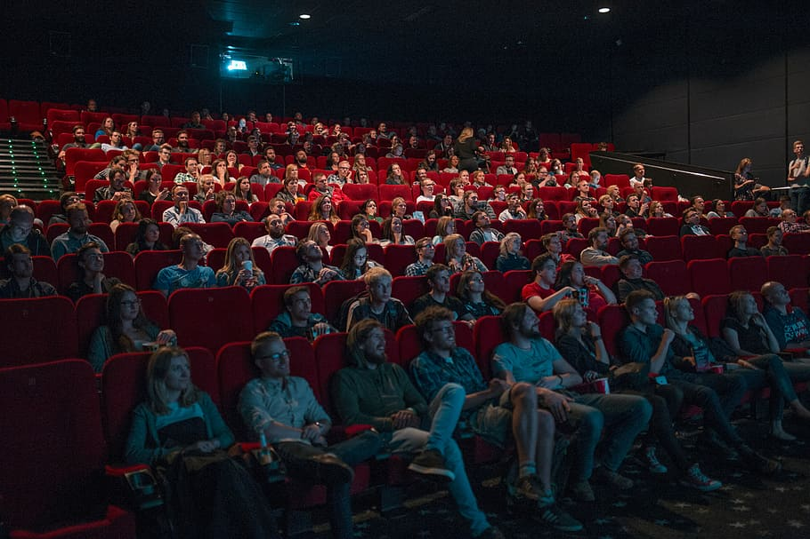
Example
Here’s a sample of reviews about a particular horror movie:
Review 1: This movie is very scary and long
Review 2: This movie is not scary and is slow
Review 3: This movie is spooky and good

Slide 21
Step 1: Vectorize the Sentences
The Bag of Words (BoW) model is the simplest form of text representation in numbers.
Like the term itself, we can represent a sentence as a bag of words vector (a string of numbers).
First build a vocabulary from all the unique words from text
The vocabulary consists of these 11 words: ‘This’, ‘movie’, ‘is’, ‘very’, ‘scary’, ‘and’, ‘long’, ‘not’, ‘slow’, ‘spooky’, ‘good’.
Review 1: This movie is very scary and long
Review 2: This movie is not scary and is slow
Review 3: This movie is spooky and good

Slide 22
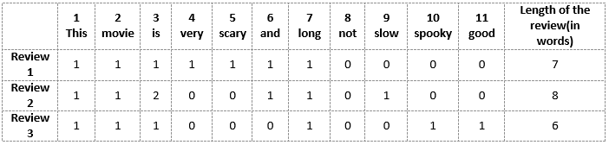
BOW model for vectorization of text (conti.)
We can now take each of these words and mark their occurrence in the three movie reviews above with 1s and 0s.
This will give us 3 vectors for 3 reviews as:
Vector of Review 1: [1 1 1 1 1 1 1 0 0 0 0]
Vector of Review 2: [1 1 2 0 0 1 1 0 1 0 0]
Vector of Review 3: [1 1 1 0 0 0 1 0 0 1 1]
Review 1: This movie is very scary and long
Review 2: This movie is not scary and is slow
Review 3: This movie is spooky and good
The vocabulary consists of these 11 words: ‘This’, ‘movie’, ‘is’, ‘very’, ‘scary’, ‘and’, ‘long’, ‘not’, ‘slow’, ‘spooky’, ‘good’.

Slide 23
Drawbacks of using BoW Model
In the above example, we can have vectors of length 11. However, we start facing issues when we come across new sentences:
If the new sentences contain new words, then our vocabulary size would increase, and thereby, the length of the vectors would increase too.
Additionally, the vectors would also contain many 0s, thereby resulting in a sparse matrix (which is what we would like to avoid)
We are retaining no information on the grammar of the sentences nor on the ordering of the words in the text.

Slide 24

TF-IDF model for vectorization of Text
Term Frequency (TF)
Let’s first understand Term Frequent (TF). It is a measure of how frequently a term, t, appears in a document, d:
Term Frequency (tf) formula
Here, in the numerator, n is the number of times the term “t” appears in the document “d”. Thus, each document and term would have its own TF value.

Slide 25
How to calculate the TF for Review #2:
Review 2: This movie is not scary and is slow
Vocabulary: ‘This’, ‘movie’, ‘is’, ‘very’, ‘scary’, ‘and’, ‘long’, ‘not’, ‘slow’, ‘spooky’, ‘good’
Number of words in Review 2 = 8
TF for the word ‘this’ = (number of times ‘this’ appears in review 2)/(number of terms in review 2) = 1/8
Similarly,
TF(‘movie’) = 1/8
TF(‘is’) = 2/8 = 1/4
TF(‘very’) = 0/8 = 0
TF(‘scary’) = 1/8
TF(‘and’) = 1/8
TF(‘long’) = 0/8 = 0
TF(‘not’) = 1/8
TF(‘slow’) = 1/8
TF( ‘spooky’) = 0/8 = 0
TF(‘good’) = 0/8 = 0
Review 1: This movie is very scary and long
Review 2: This movie is not scary and is slow
Review 3: This movie is spooky and good

Slide 26
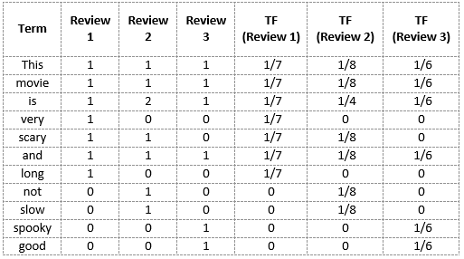
Calculate the term frequencies for all the terms and all the reviews

Slide 27

Calculate IDF
IDF is a measure of how important a term is.
We need the IDF value because computing just the TF alone is not sufficient to understand the importance of words:
calculate the IDF values for the all the words in Review 2:
IDF(‘this’) = log(number of documents/number of documents containing the word ‘this’) = log(3/3) = log(1) = 0

Slide 28
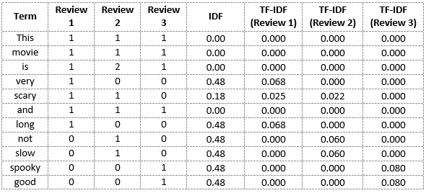
IDF
Similarly,
TF-IDF(‘movie’, Review 2) = 1/8 * 0 = 0
TF-IDF(‘is’, Review 2) = 1/4 * 0 = 0
TF-IDF(‘not’, Review 2) = 1/8 * 0.48 = 0.06
TF-IDF(‘scary’, Review 2) = 1/8 * 0.18 = 0.023
TF-IDF(‘and’, Review 2) = 1/8 * 0 = 0
TF-IDF(‘slow’, Review 2) = 1/8 * 0.48 = 0.06
Similarly, we can calculate the TF-IDF scores for all the words with respect to all the reviews:
We have now obtained the TF-IDF scores for our vocabulary. TF-IDF also gives larger values for less frequent words and is high when both IDF and TF values are high

Slide 29
BoW vs TF-IDF
Bag of Words just creates a set of vectors containing the count of word occurrences in the document (reviews), while the TF-IDF model contains information on the more important words and the less important ones as well.
Bag of Words vectors is easy to interpret. However, TF-IDF usually performs better in machine learning models.

Slide 30
Assignment
Explorer the Word Embedding techniques such as Word2Vec, Continuous Bag of Words (CBOW), Skipgram, etc.
Solve an example and upload it to the classroom.

